Slide 1
Weighted Ensemble Data Analysis and Plotting
(wedap)
12Oct2022

Slide 2
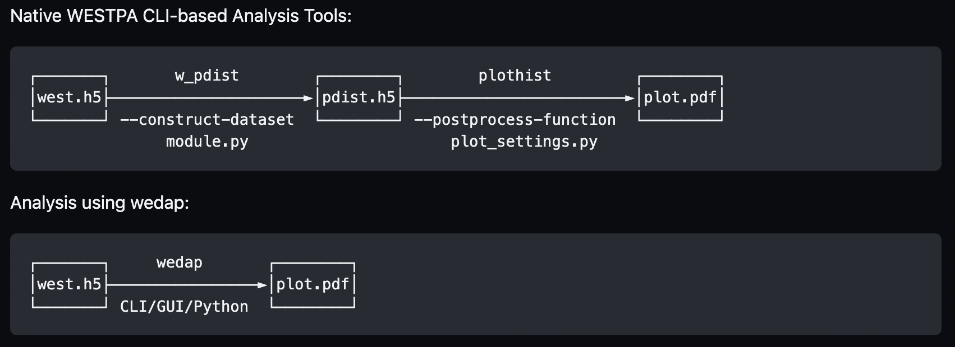
Motivation: easy plotting of aux datasets

Slide 3
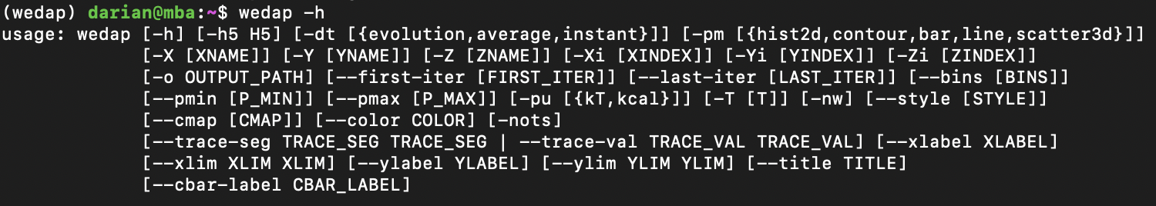
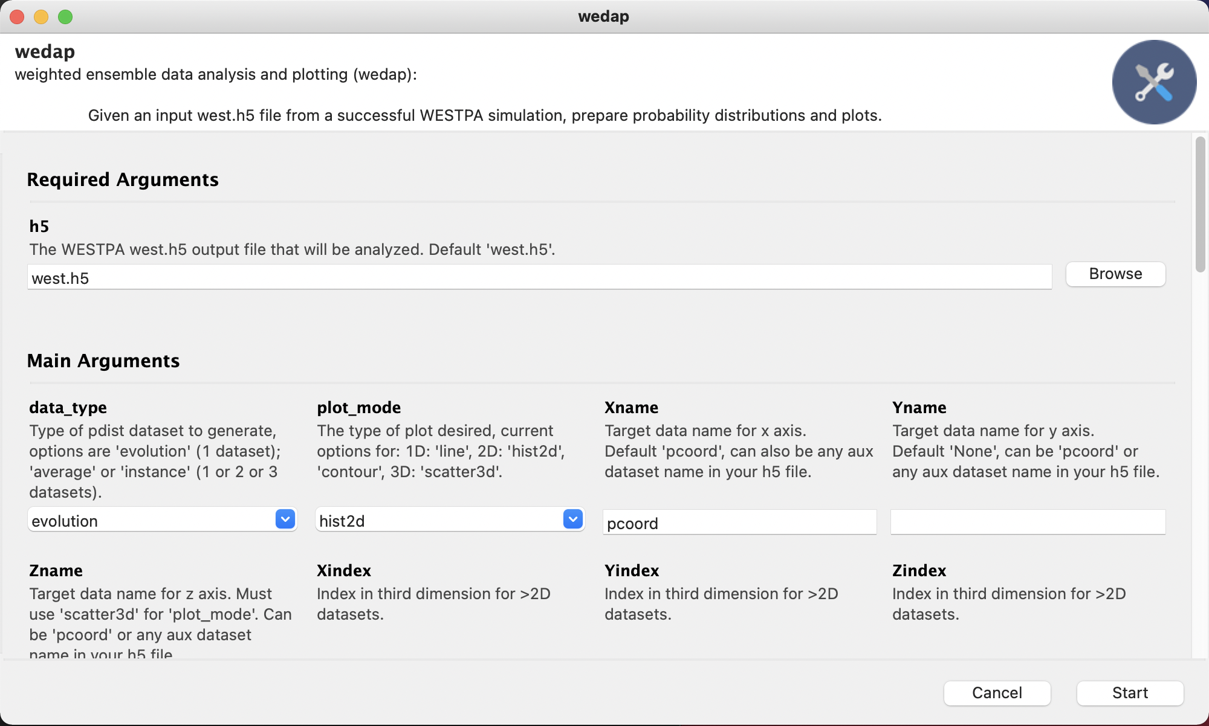
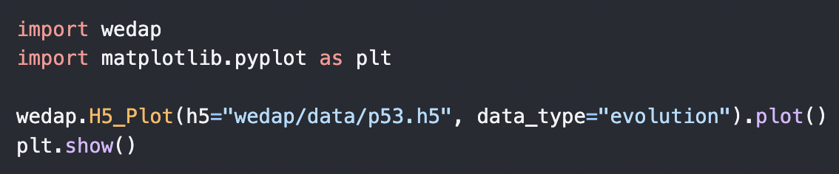
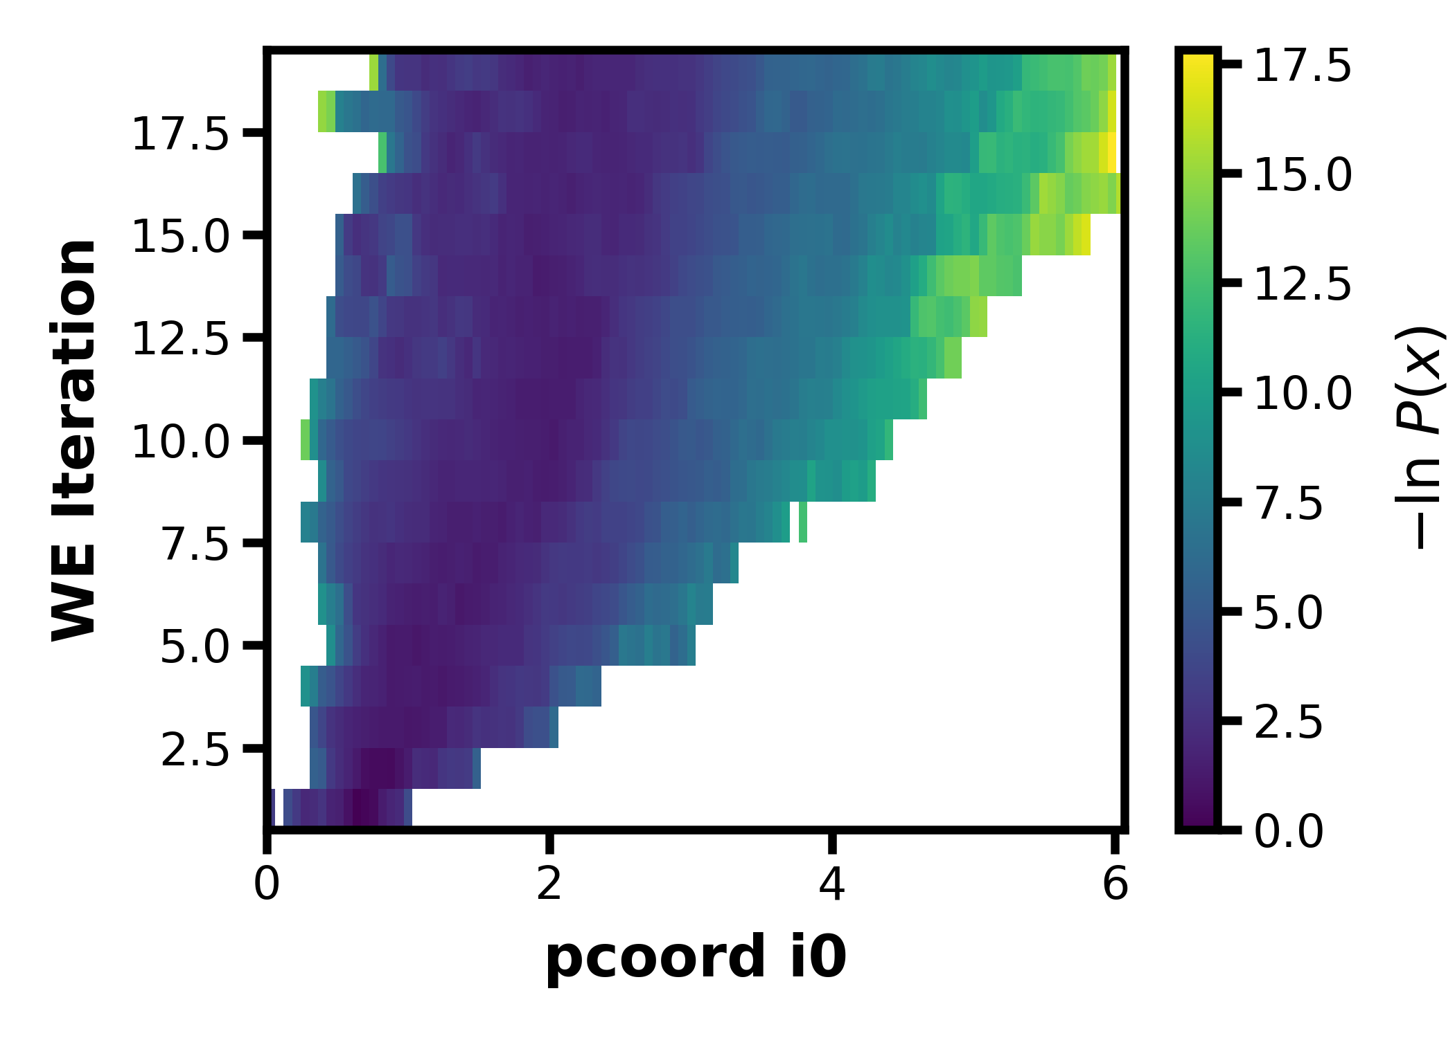
GUI/CLI/API

Slide 4
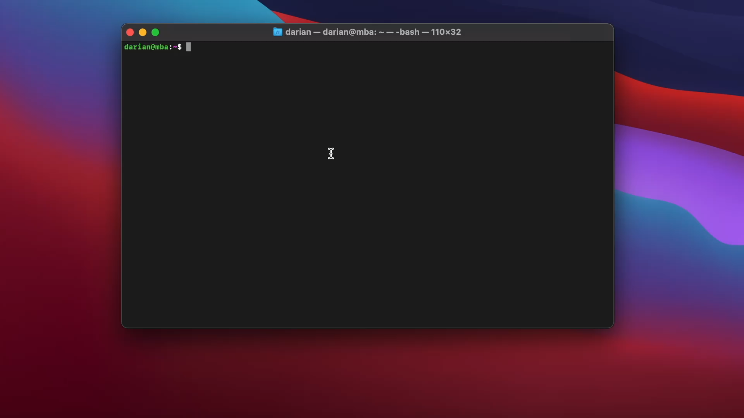
Demo:

Slide 5
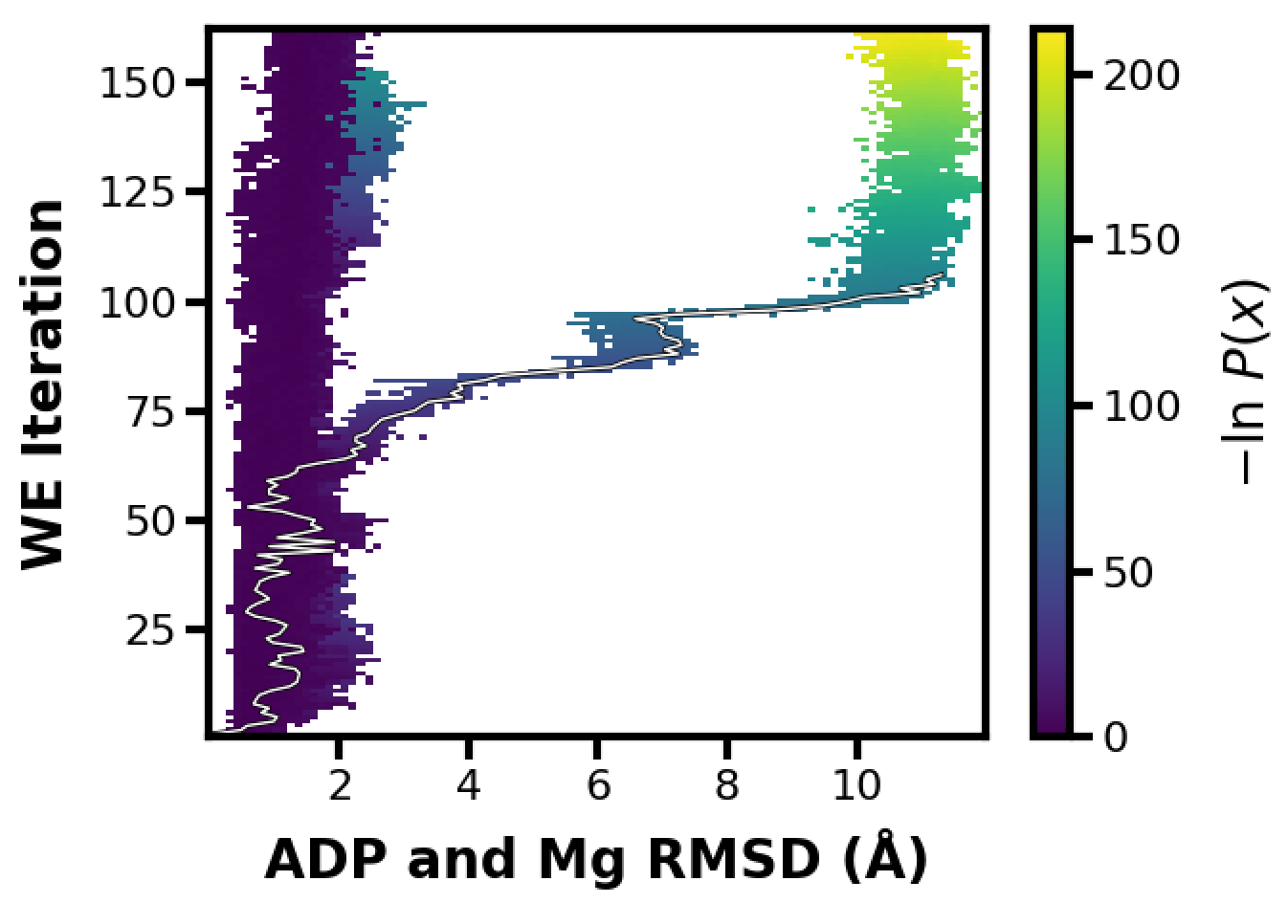
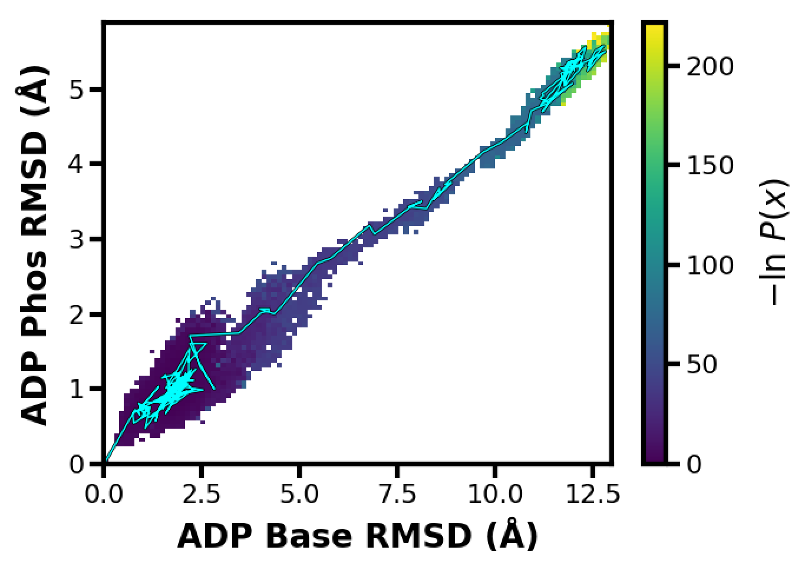
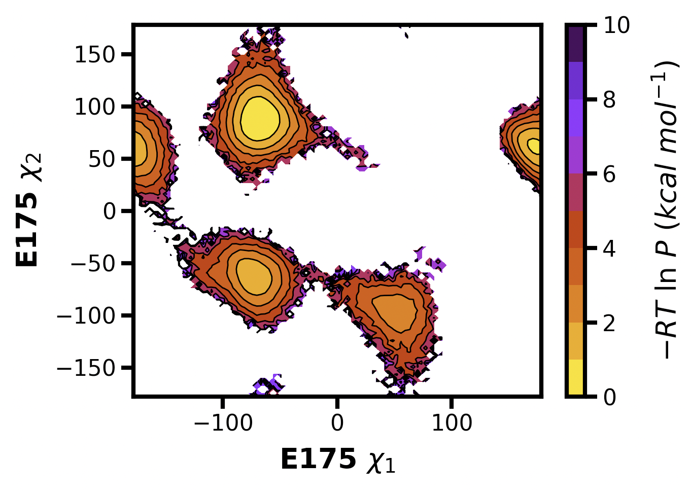
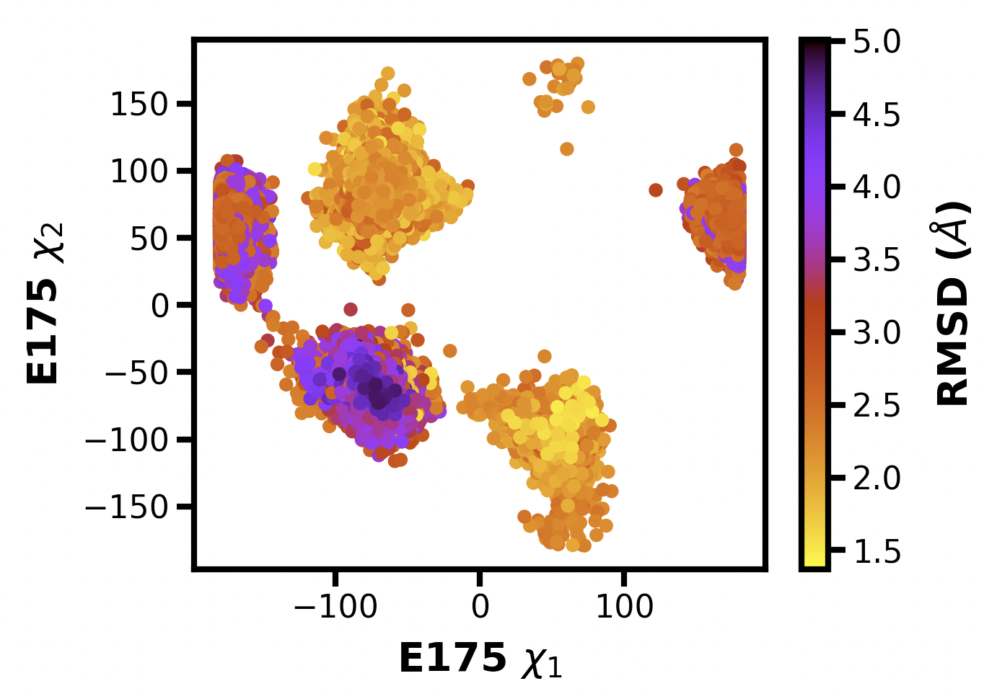
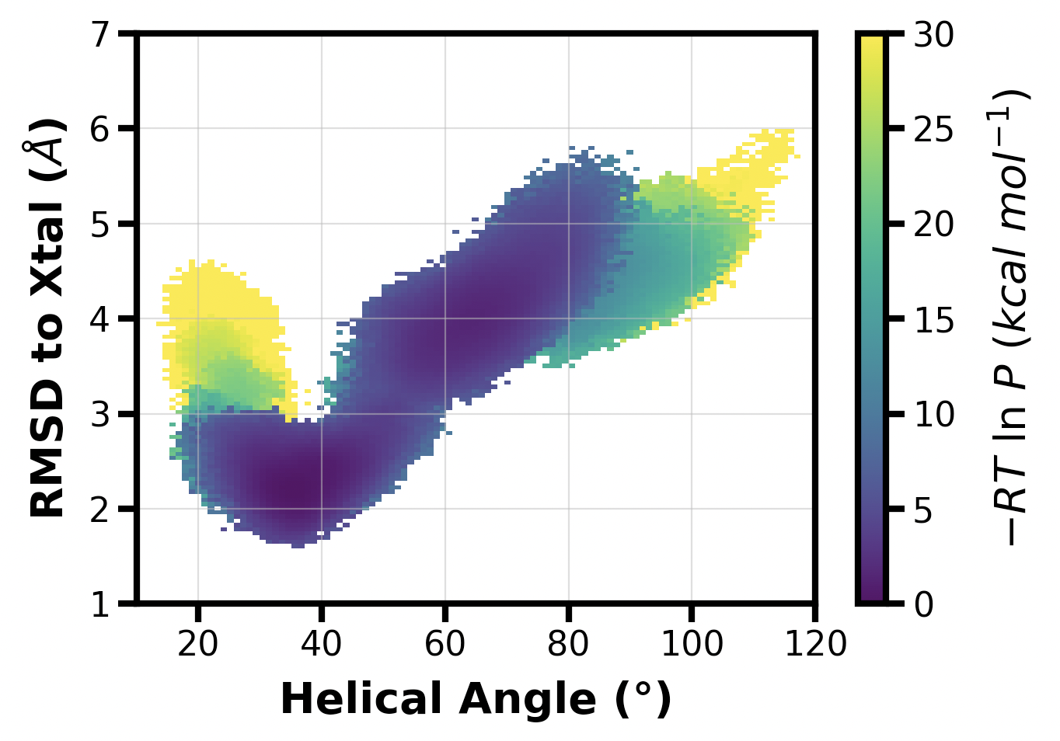
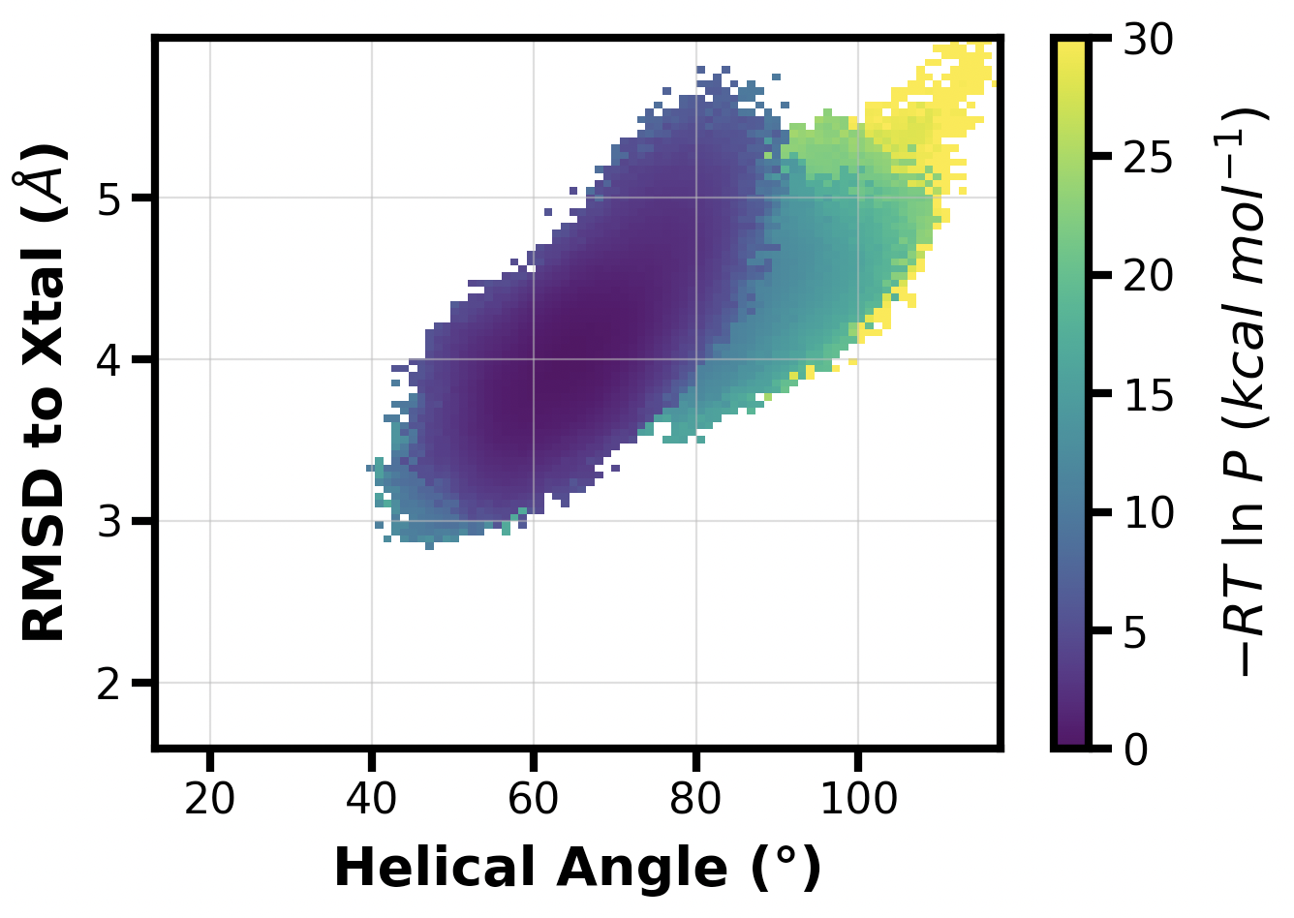
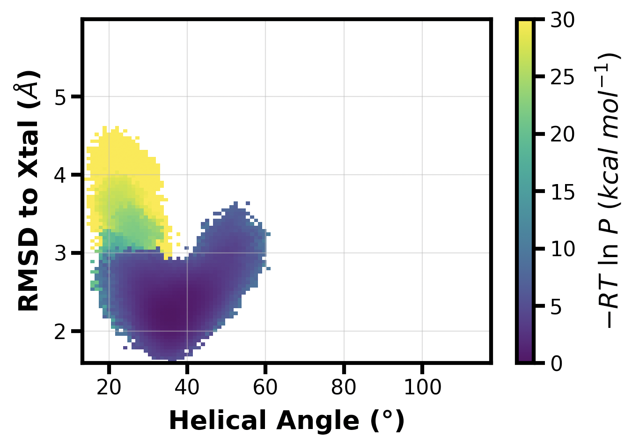
Examples
Trace with iter, seg or x_val, y_val
3D Plots
Selective Basis States

Slide 6
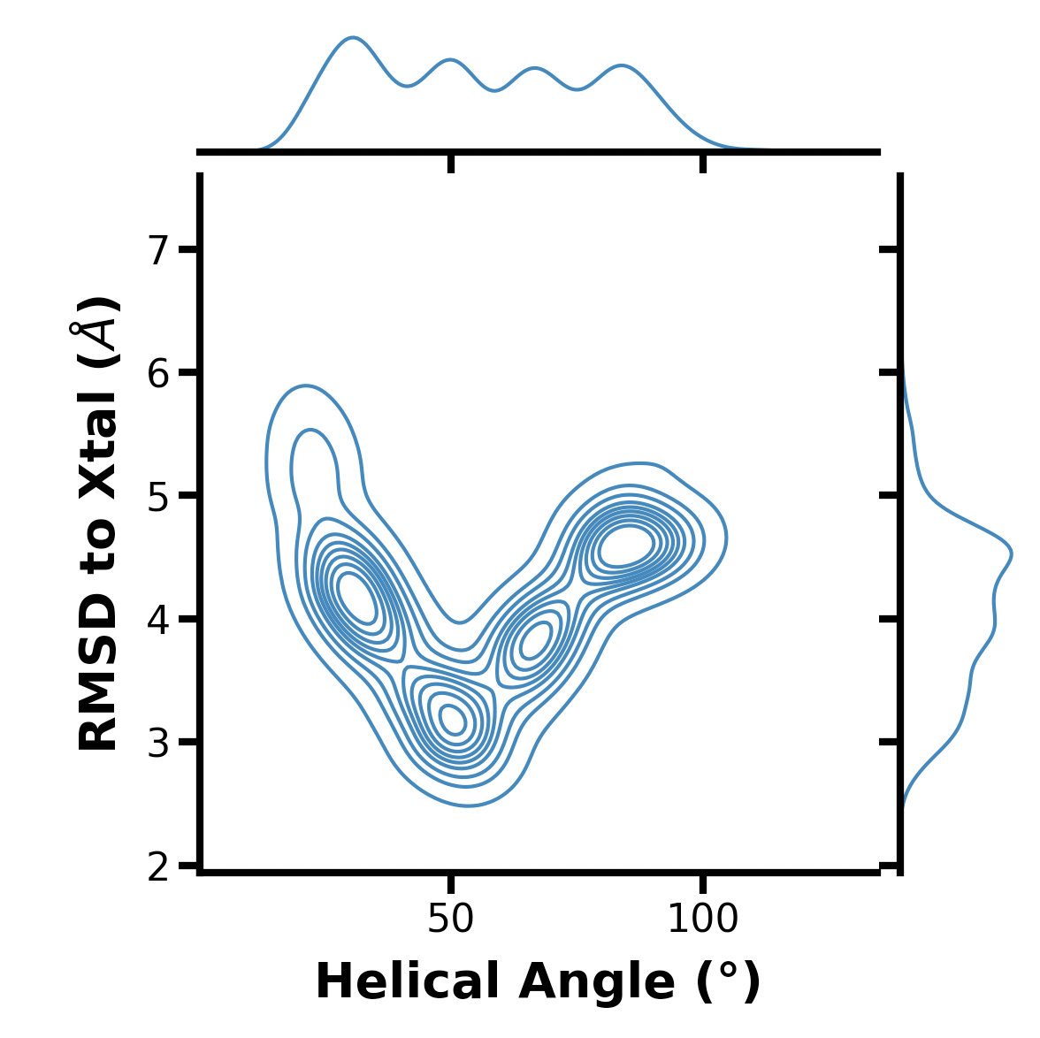
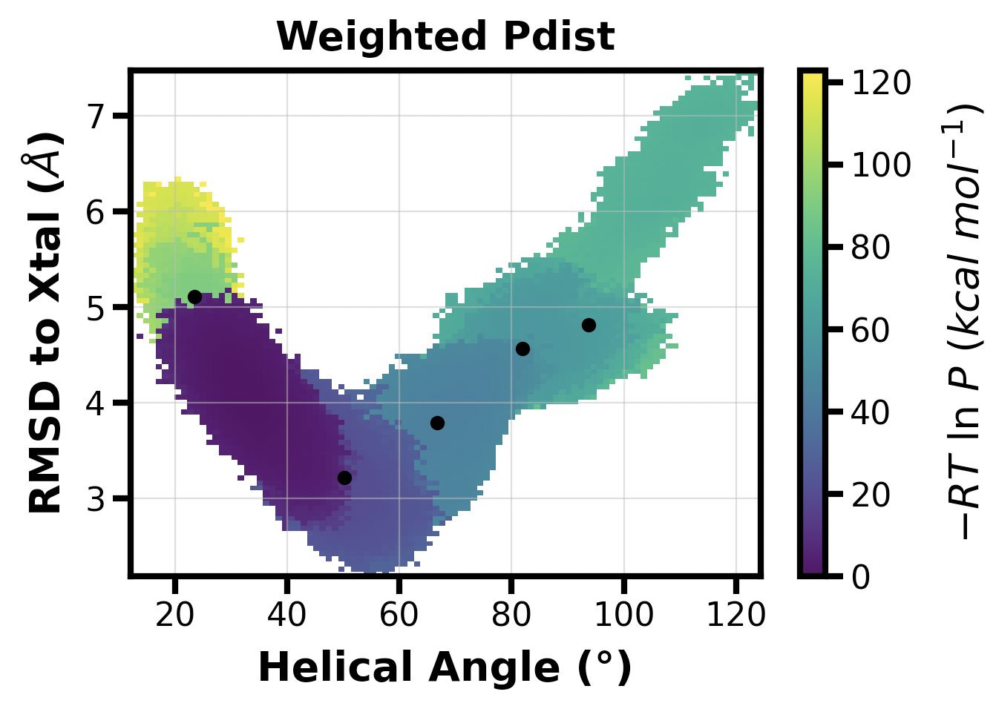
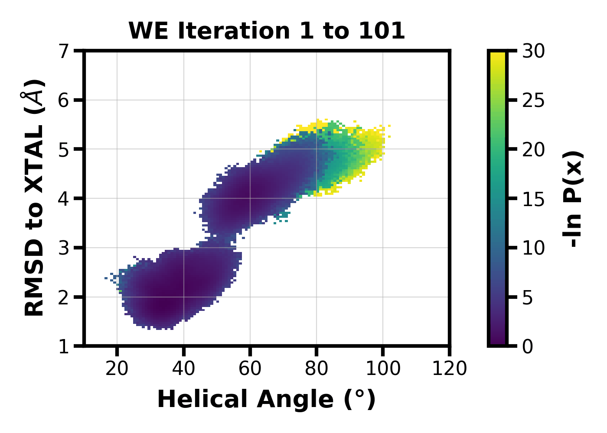
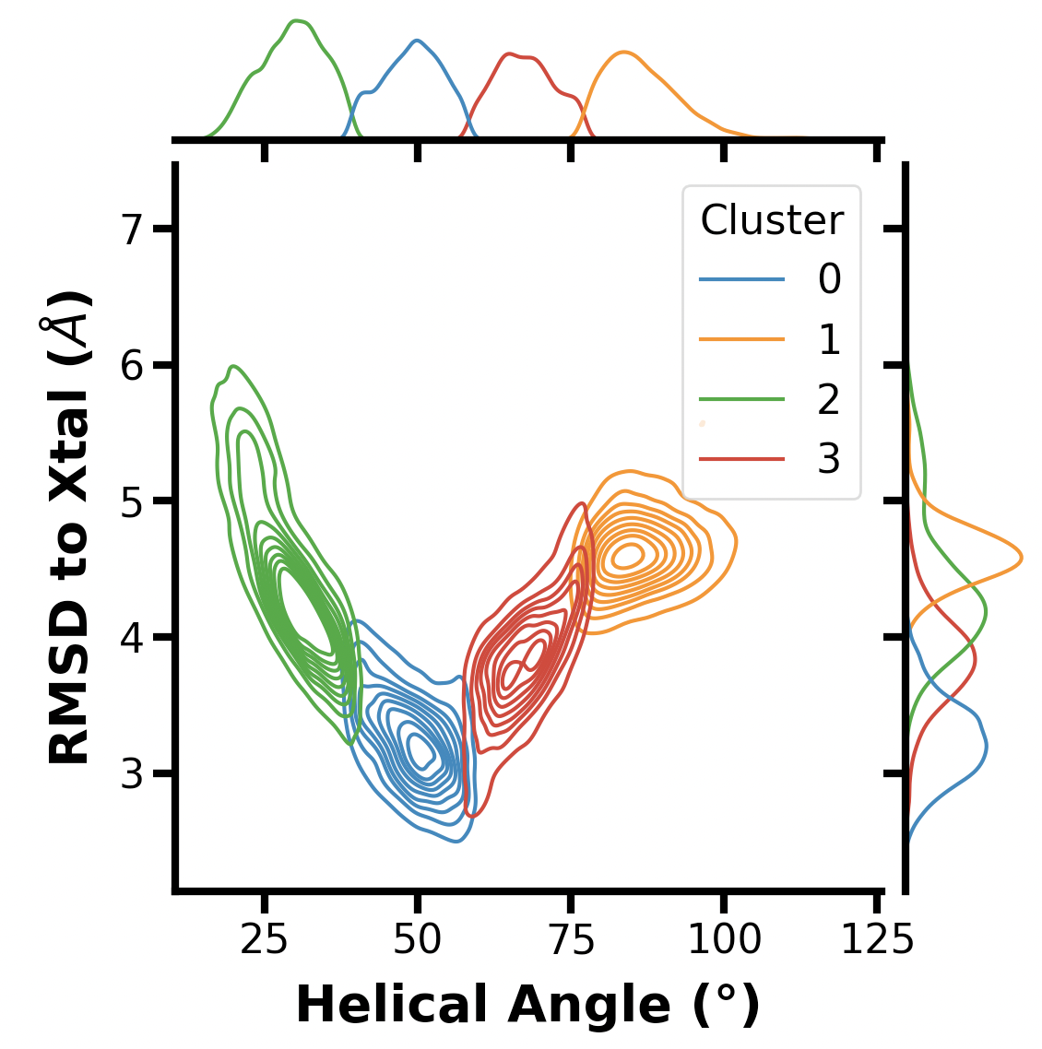
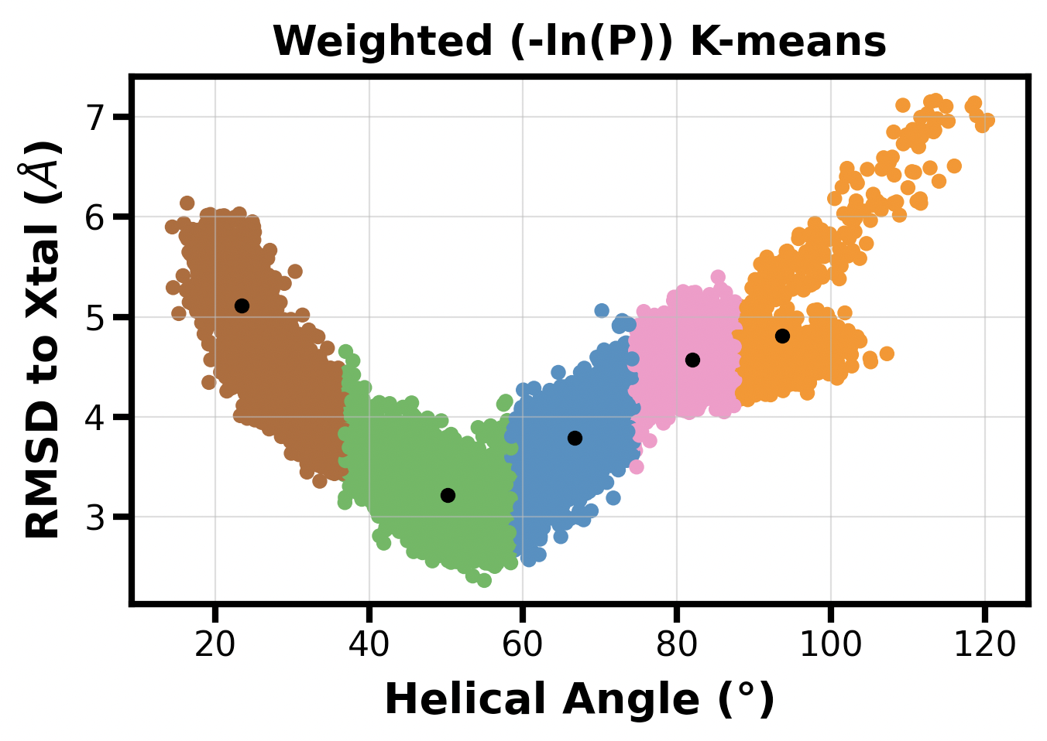
Easy Interfacing with Other Python Packages
Seaborn
Scikit-learn
Moviepy
Seaborn + sklearn

Slide 7
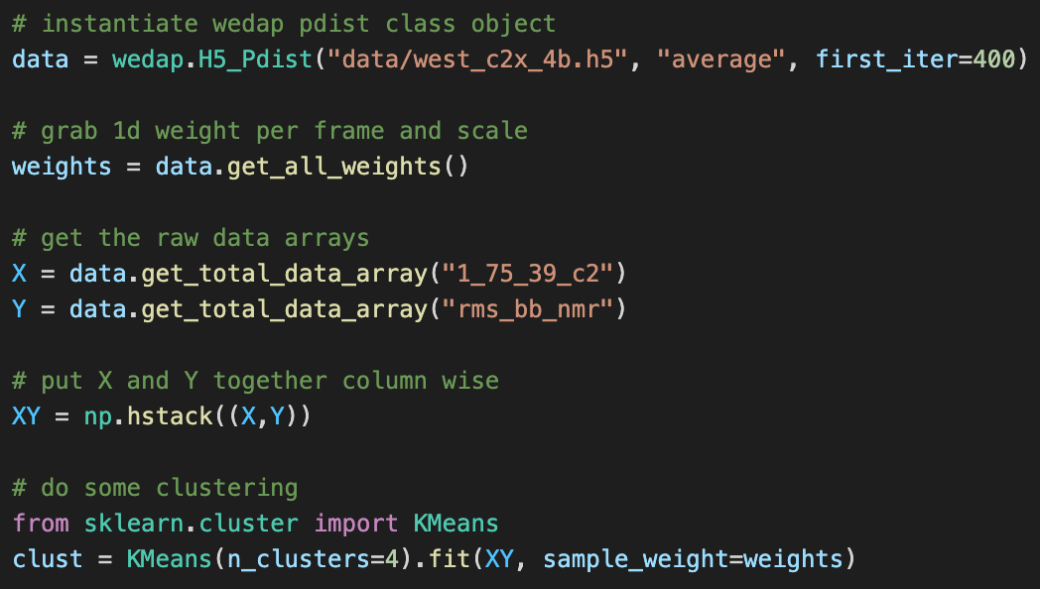

Slide 8
Want to try it for yourself?
https://github.com/darianyang/wedap
If the GUI is not needed:
pip install wedap
If you want the GUI:
conda install -c conda-forge gooey
pip install wedap
Upcoming Features
Multiple H5 files
Filtering for succ traj only
Using assign.h5?
User-friendly movie making
Have an idea? Let me know!

